Slide 1

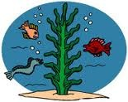

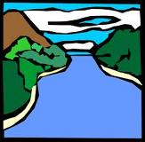

Rain washes the chemicals into rivers such as the Mississippi.
The chemicals flow down the river where they get washed into the ocean.
Eutrophication occurs when too many nutrients cause plankton blooms.
Plankton use up all of their resources and die off.
Bacteria break down the plankton and use up all of the oxygen in the water, resulting in a “Dead Zone.”
Agricultural runoff puts lots of nitrogen and phosphorous into the soil.

