Slide 1
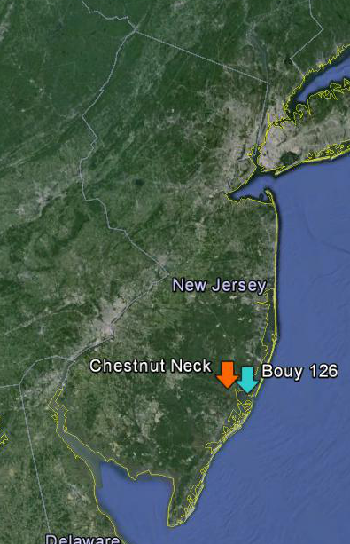

Slide 2
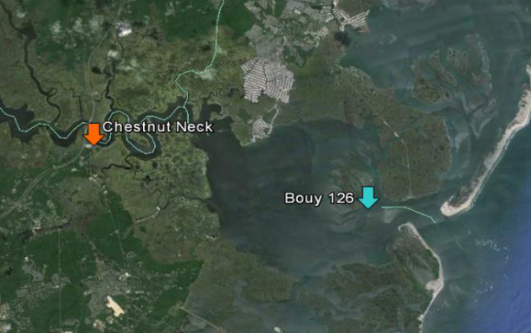

Slide 7
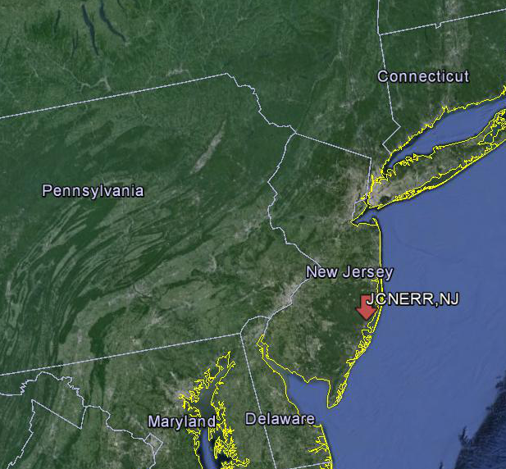

Slide 8
JCNERR SWMP Station Map

Slide 9
Mid-Atlantic Region

Slide 11
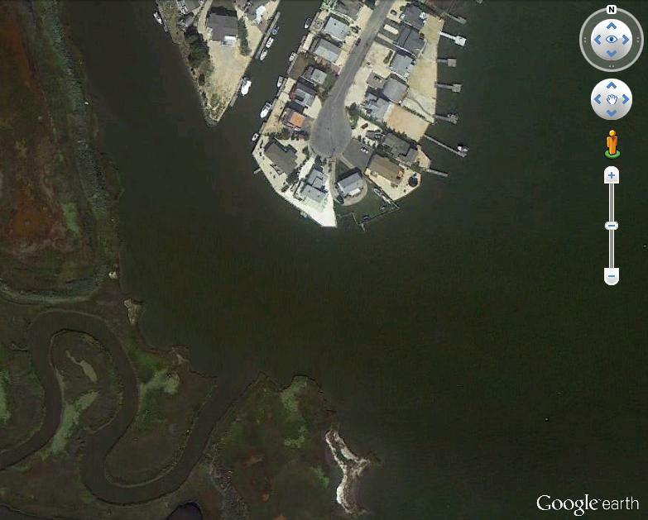
Tuckerton Cove
Before Sandy

Slide 12
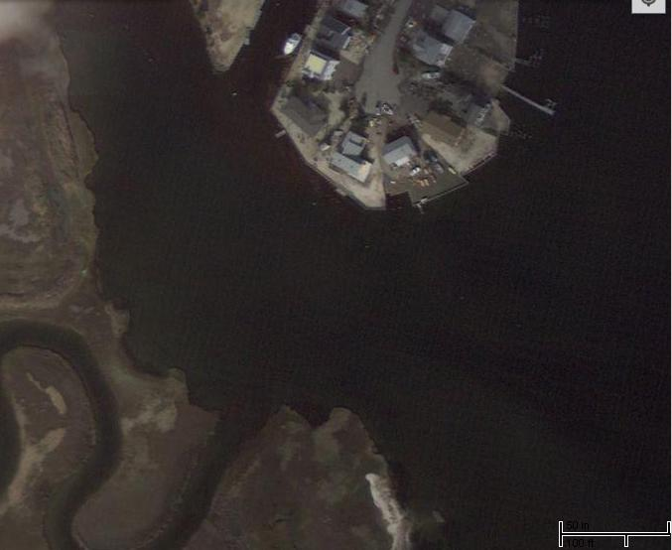
Tuckerton Cove
After Sandy

Slide 13
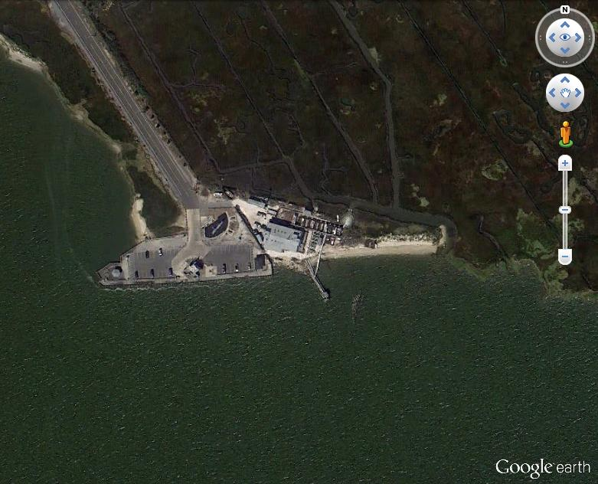
Parson’s Clam Hatchery Before Sandy

Slide 14
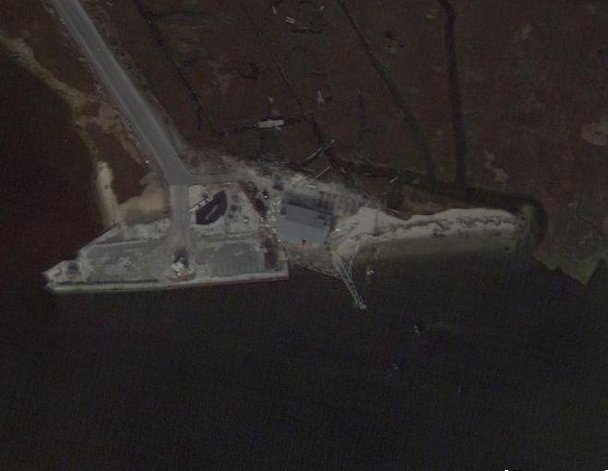
Parson’s Clam Hatchery
After Sandy

Slide 15
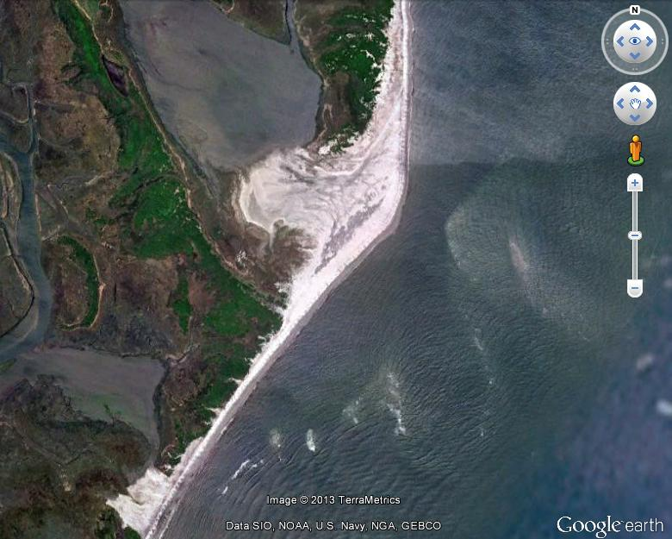
Little Beach Before Sandy

Slide 16
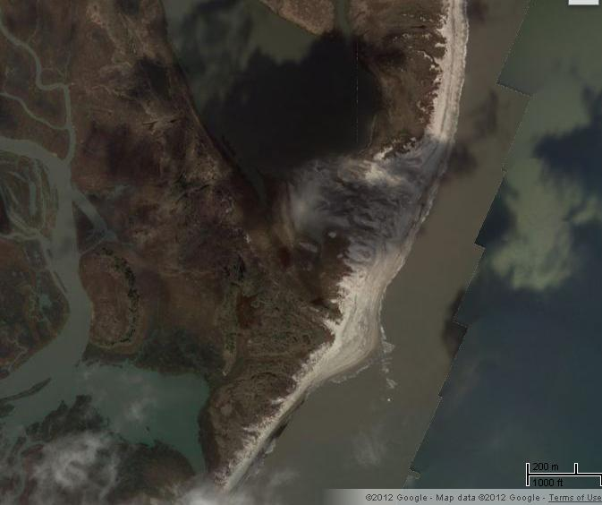
Little Beach
After Sandy

